Slide 1
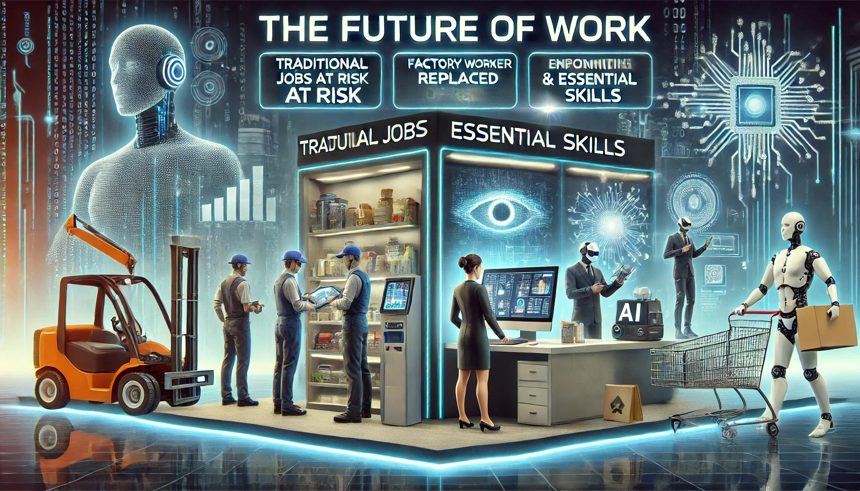
Future of Work: At-Risk Jobs & Essential Skills
Adapting to Automation & AI
Team Members:
Rayyan Dossani, Akbar Younsi, Saad Khan, Ali Hasnain, Umer Karim, Abdul Wahab

Slide 2
Introduction: Technology is evolving at a rapid pace, and it is reshaping the job market. Some jobs are being replaced by automation and AI, while new opportunities are emerging. This presentation explores which jobs are at risk and the skills that will be crucial for the future workforce. Key Questions: Which jobs are at risk due to automation? What skills will be in high demand in the future?

Slide 3
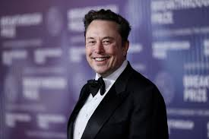
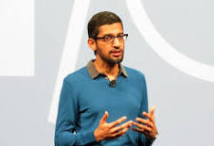
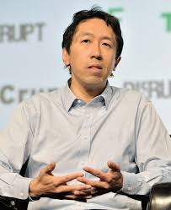
Future of Work: Expert Opinions & Trends:
Elon Musk: "AI will be the best or worst thing ever for humanity. We must be careful.“
Sundar Pichai (Google CEO): "AI will be more profound than fire or electricity.“
Andrew Ng (AI Expert): "AI is the new electricity—it will transform every industry."

Slide 4



World Economic Forum (WEF) Report: By 2025, automation will create 97 million new jobs but displace 85 million. McKinsey Global Institute: AI will automate 30% of tasks in most industries by 2030. PwC Report: AI will contribute $15.7 trillion to the global economy by 2030.

Slide 5
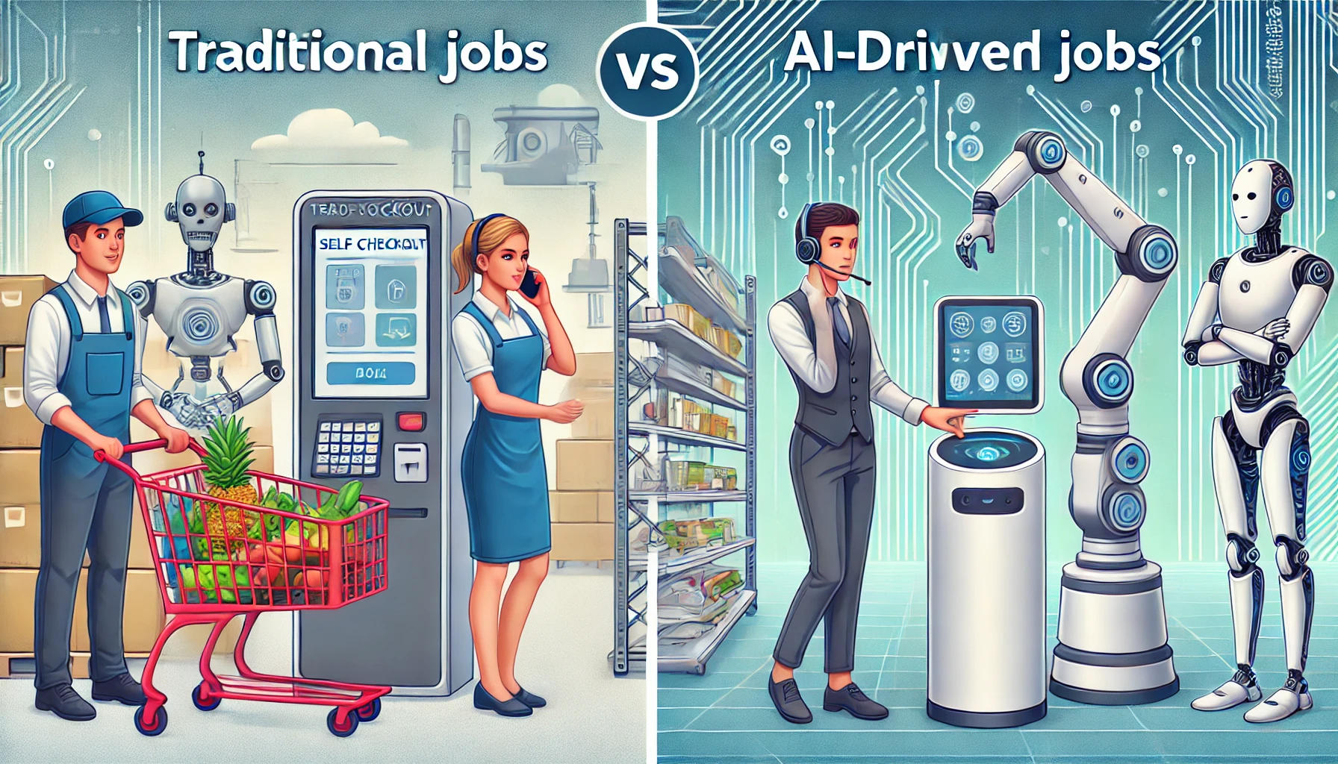
Jobs at Risk (Automation & AI Impact): Manufacturing & Assembly Retail & Cashiers Data Entry & Clerical Work Telemarketing & Customer Service Transportation (Drivers, Delivery Workers)

Slide 6
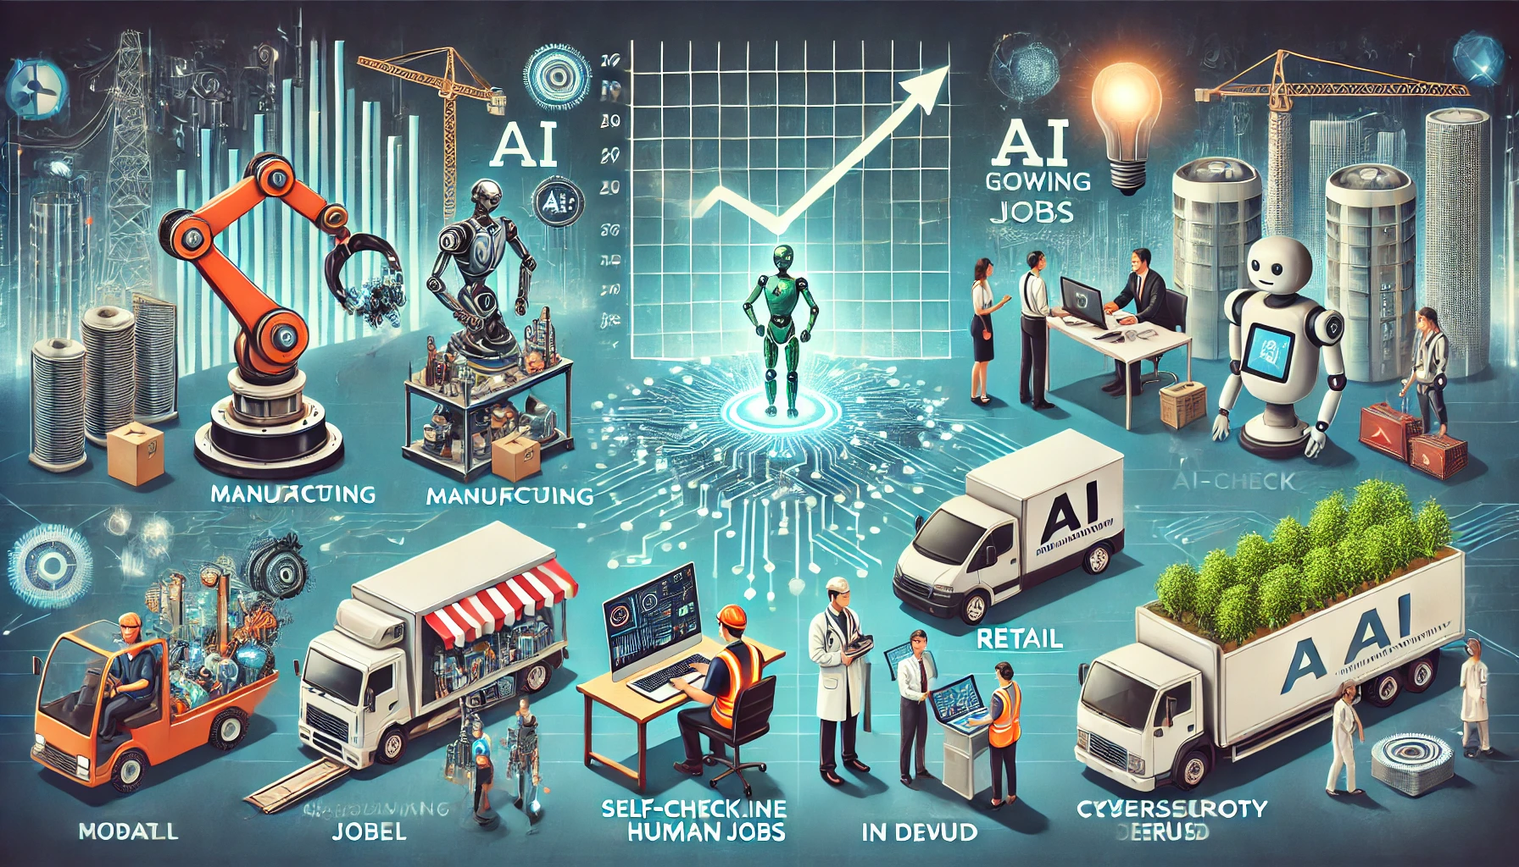
Industry-Wise Impact of AI & Automation Key Industries Affected: 📉 Declining Sectors: Manufacturing Retail Transport Administration 📈 Growing Sectors: Tech & AI Healthcare Green Energy Cybersecurity

Slide 7
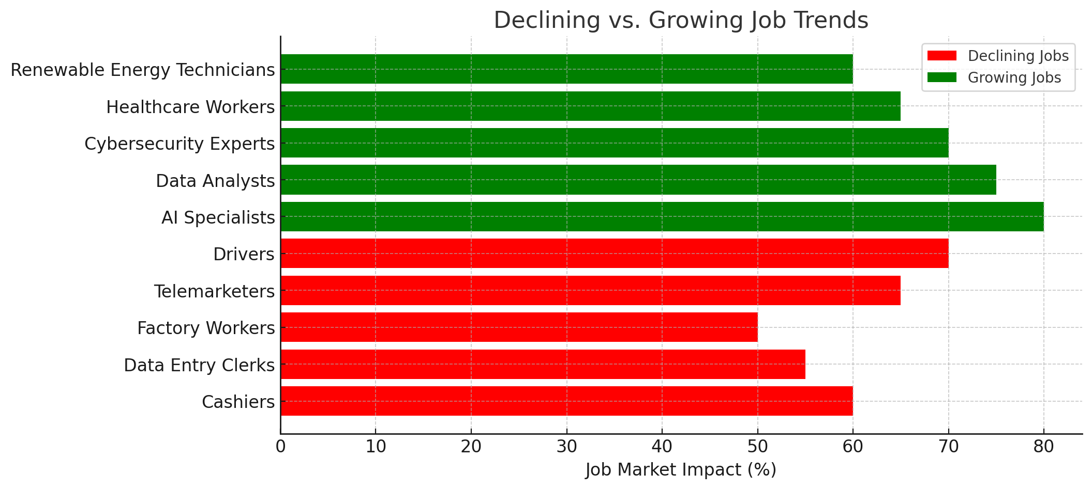
Emerging & Resilient Jobs: High-Growth Job Sectors: AI & Machine Learning Specialists Data Scientists & Analyst Cybersecurity Experts Healthcare Professionals Renewable Energy Technicians Creative Roles (Designers, Writers, Content Creators)

Slide 8
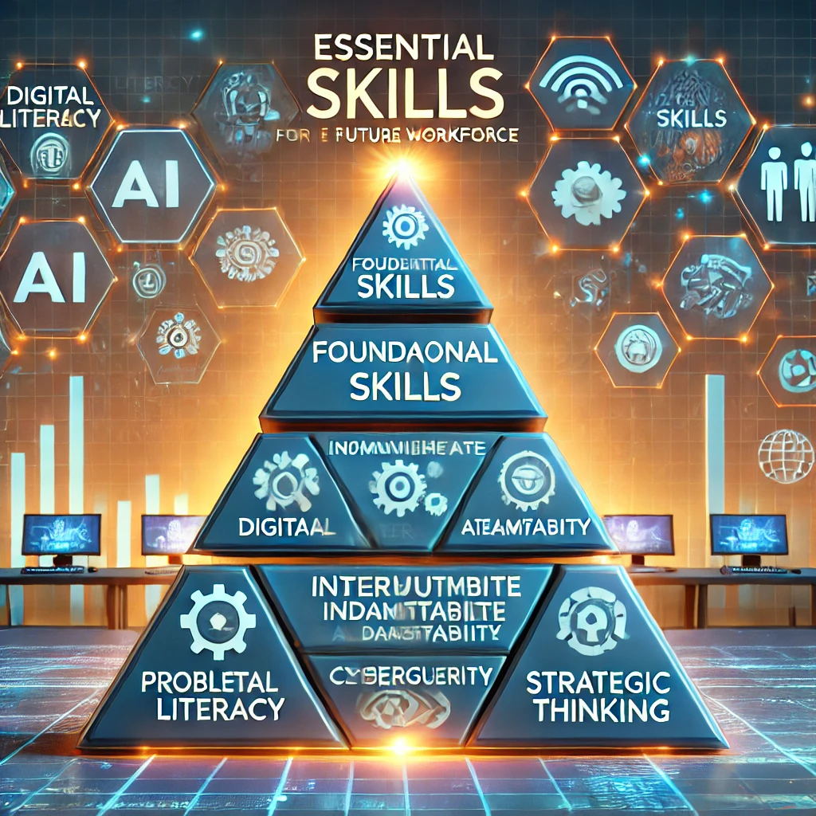
Essential Future Skills: To remain employable in the future, both technical and soft skills will be critical. Technical Skills: AI & Data Literacy Cloud Computing & Cybersecurity Robotics & Automation Soft Skills: Critical Thinking & Problem-Solving Emotional Intelligence & Creativity Adaptability & Lifelong Learning

Slide 9
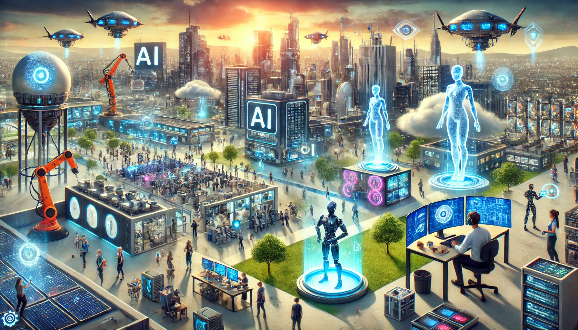
AI & Job Creation – The Positive Side: • AI-driven jobs: AI specialists, automation engineers, AI trainers • Growth in AI-related industries (robotics, cybersecurity, cloud computing) • How AI is helping create new business models • Collaboration between AI and human intelligence

Slide 10
The Role of AI & Human Collaboration: AI Will Not Replace But Enhance Human Work! AI excels at: Automating repetitive tasks Processing large datasets Improving efficiency Humans excel at: Creativity & innovation Emotional intelligence Ethical decision-making Future of Work = AI + Human Collaboration

Slide 11
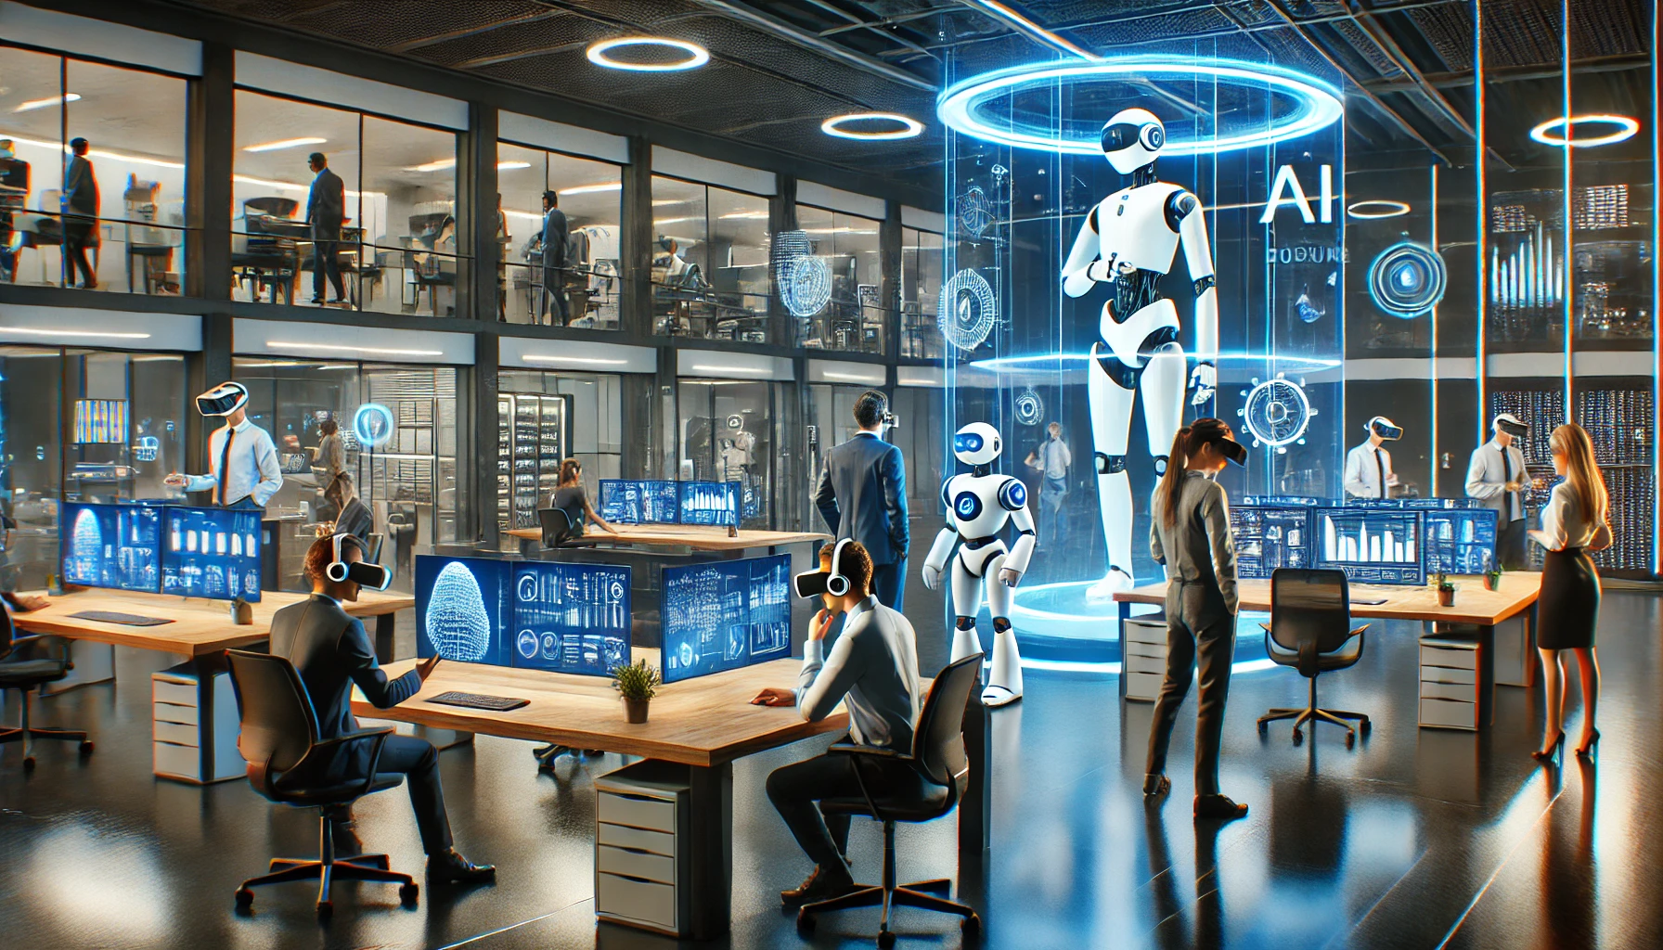
The Future Workplace – What Will It Look Like? Office Work: Hybrid work models (remote + in-person) Automation Gig Economy Growth Augmented Reality (AR) & Virtual Reality (VR)
Workplace Evolution

Slide 12
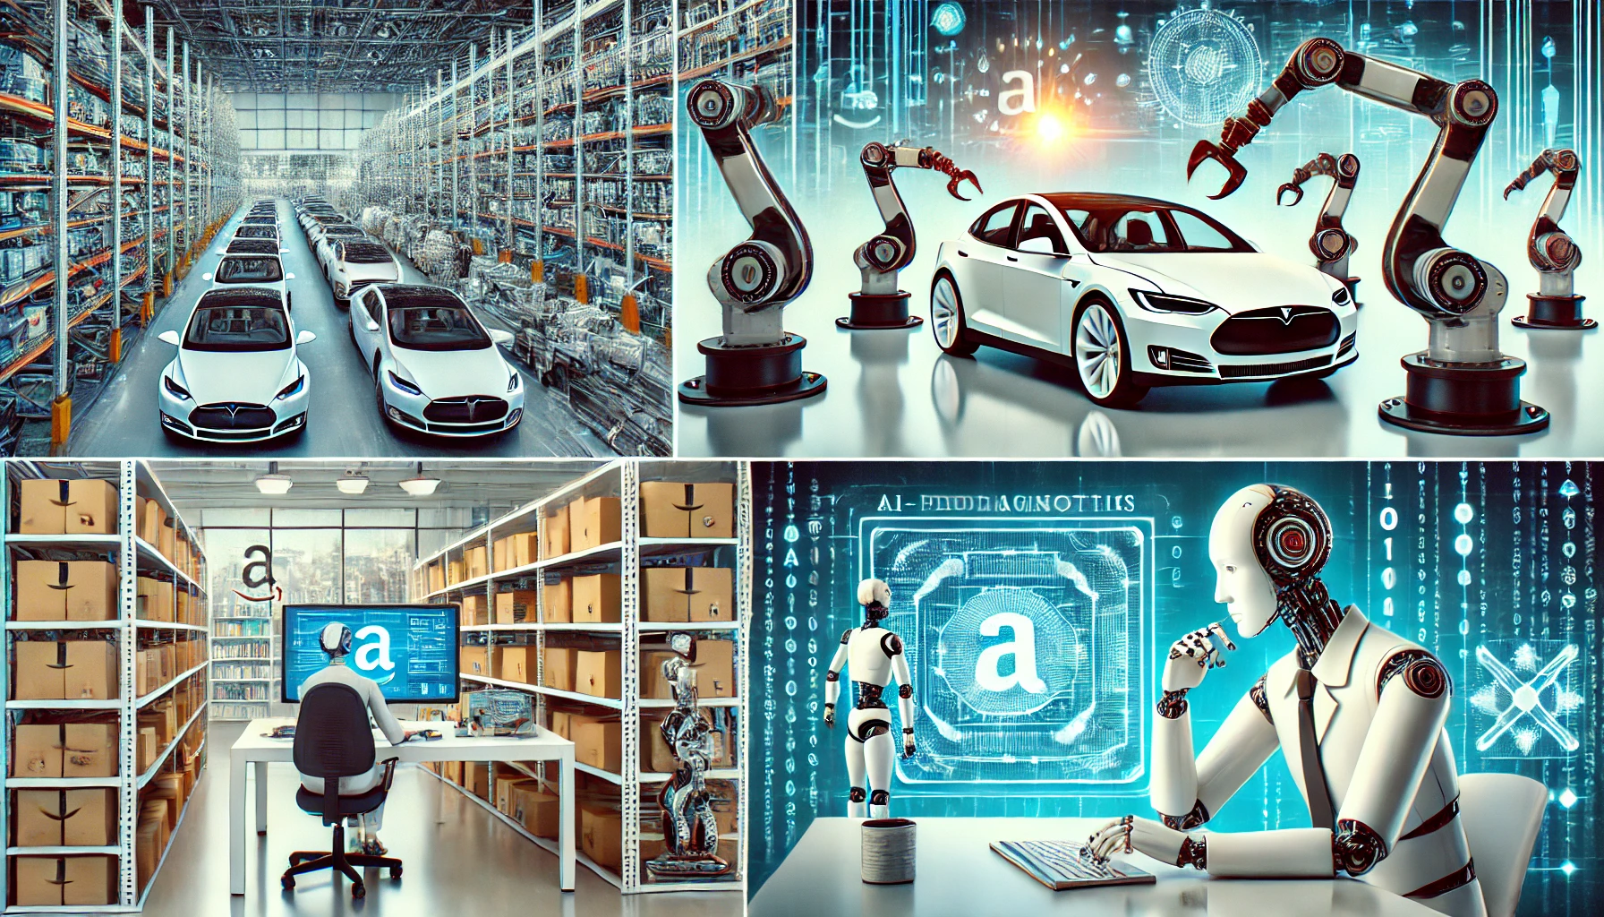
Case Studies & Real-World Examples: • Tesla: AI-driven manufacturing and self-driving technology • Amazon: Warehouse automation and smart logistics • Google: AI in search, healthcare, and workplace productivity • Success stories of professionals who adapted to AI-driven changes

Slide 13
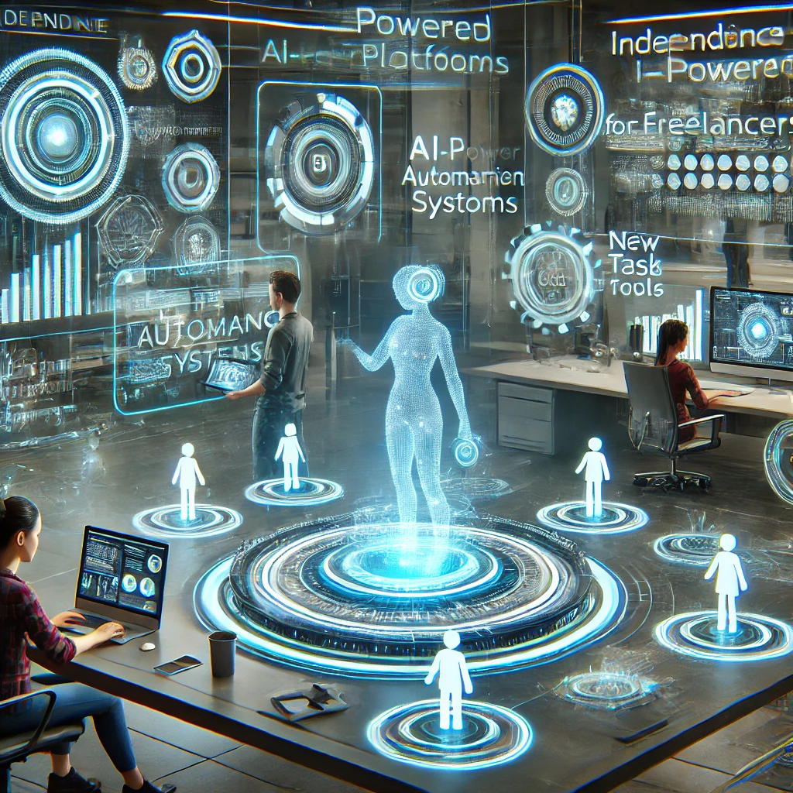
Impact of AI on Freelancing & the Gig Economy: • AI-powered platforms for freelancers • How automation affects independent workers • Future skills required for successful freelancing • New gig opportunities in AI-powered fields

Slide 14
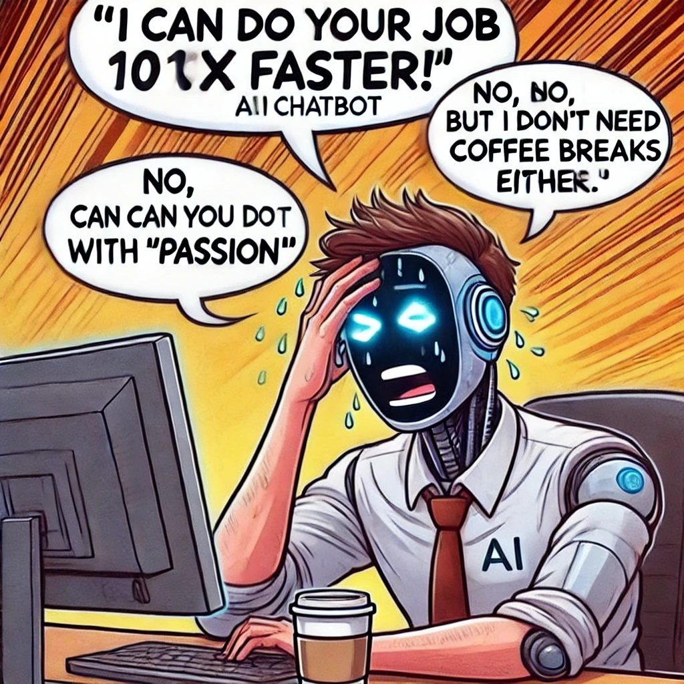
Ethical & Social Implications of AI in Work: • Job displacement & economic inequality • AI bias and ethical concerns • Workplace surveillance and privacy issues • Government regulations and AI policies

Slide 15



Reskilling & Upskilling Resources: • Top online platforms: Coursera, Udemy, edX, LinkedIn Learning • Government & corporate training programs • AI-focused certifications & bootcamps • Importance of continuous learning & adaptability

Slide 16
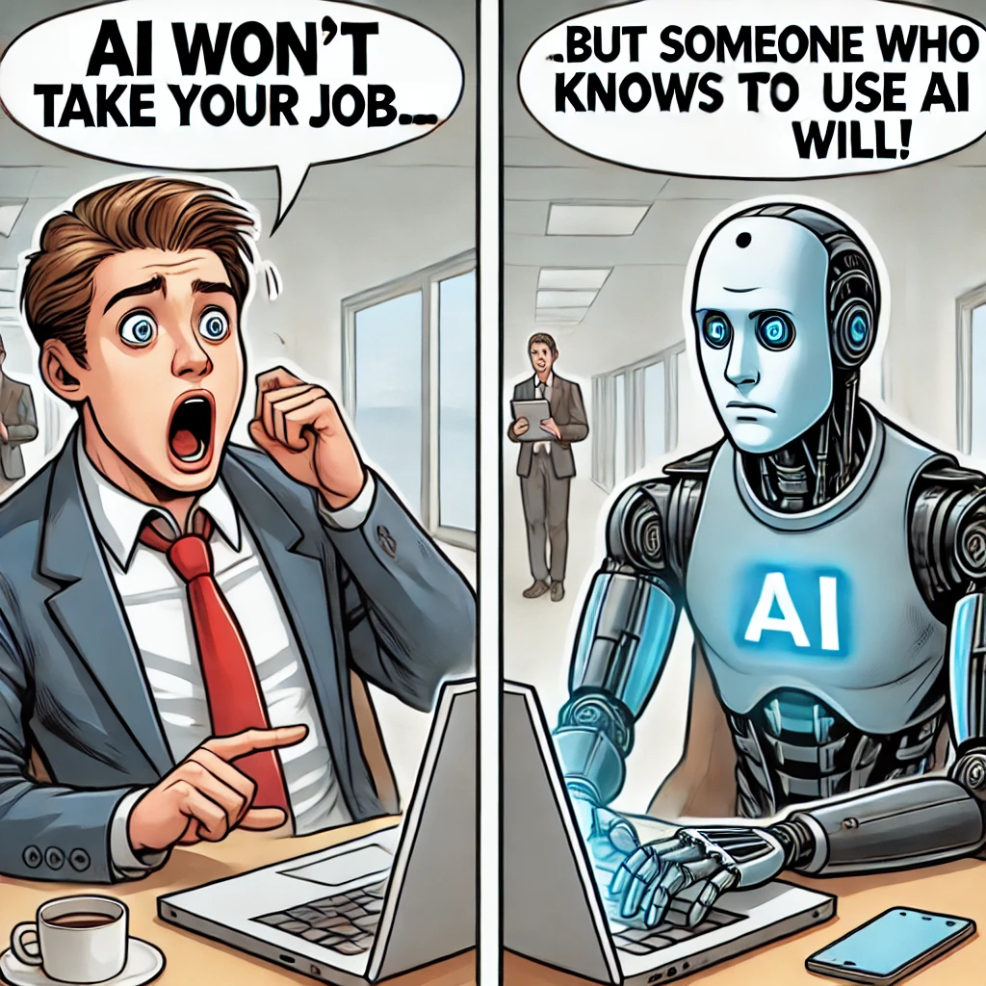
Conclusion & Call to Action: Key Takeaways: Some jobs will decline, but new opportunities will arise. AI will complement human skills, not completely replace them. Lifelong learning and adaptability are crucial for career success. Invest in upskilling and embrace new technologies. Question for the Audience: “What steps will you take today to secure your future career?”

Slide 17
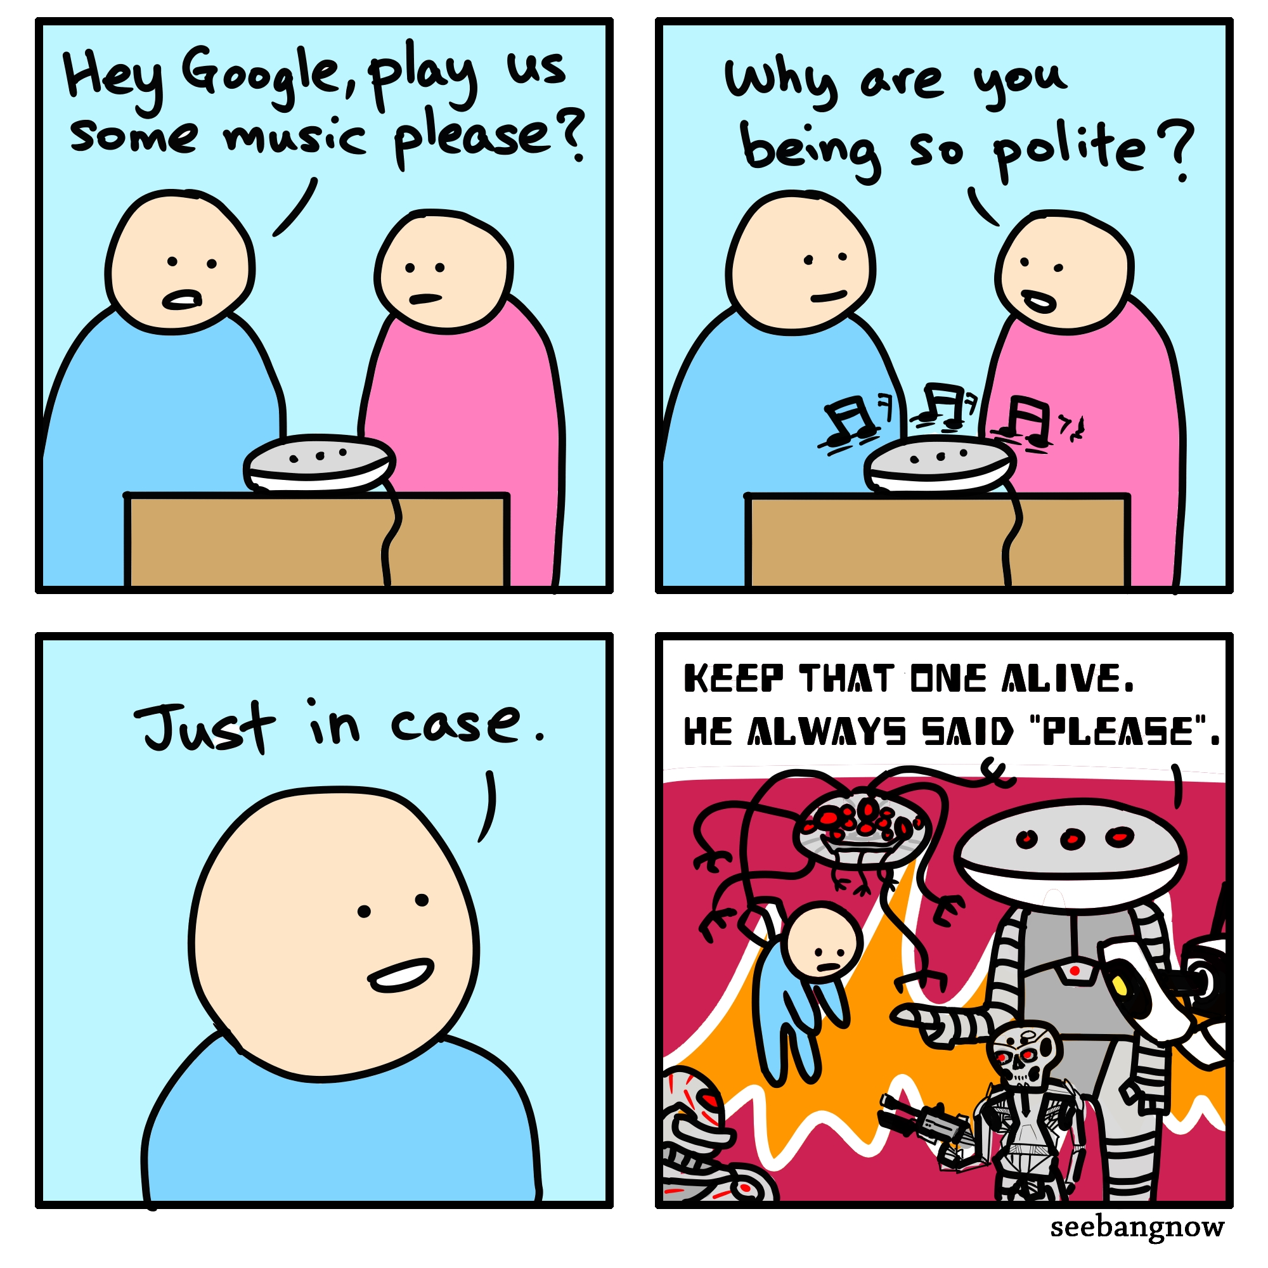
THE END
THANK YOU!

